Slide 1
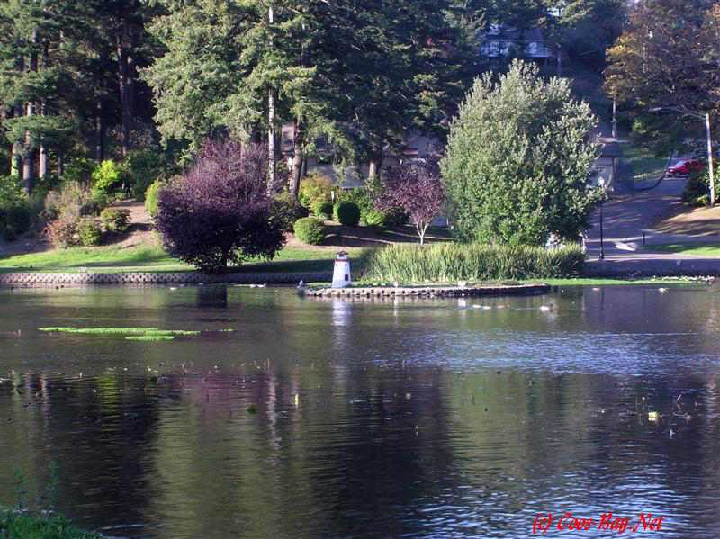
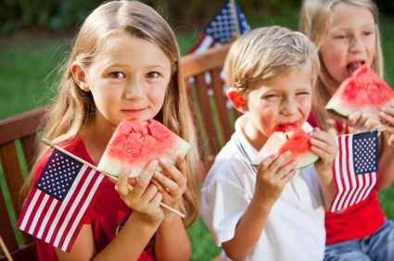
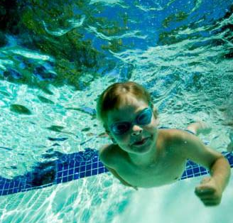
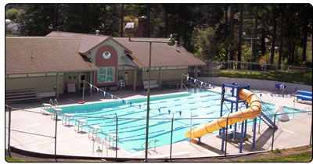
Master Plan Survey Results
October 2012
City of Coos Bay
COMPREHENSIVE PARK AND RECREATION SYSTEM MASTER PLAN

Slide 2
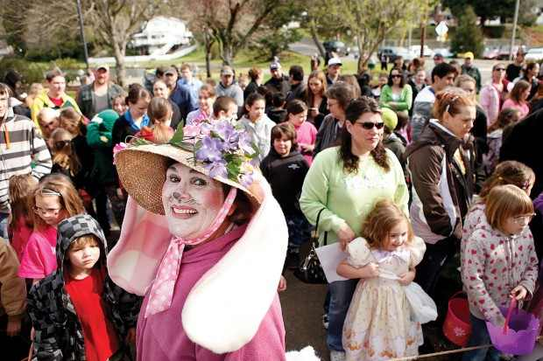
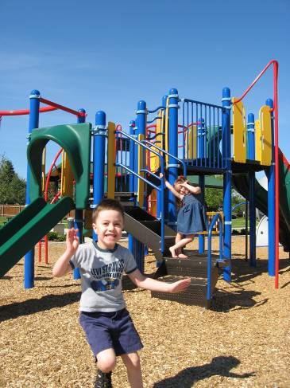
Question 1: What is your age?

Slide 3



Question 2: Are you male or female?
Notes:
220 Female took the survey.
90 Male took the survey.

Slide 4
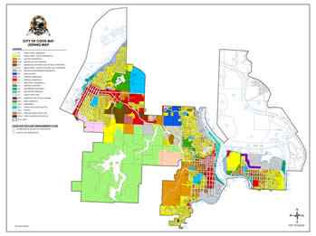
Question 3: Where Do You Live?
Notes:
199 who took the survey live in Coos Bay.
111 who took the survey live in Coos County.

Slide 5
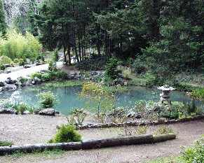
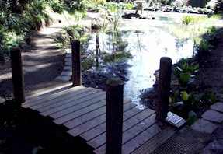
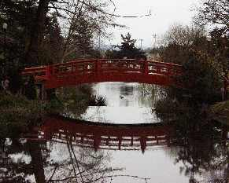
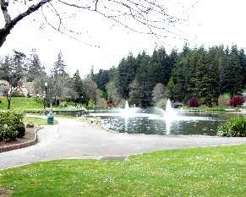
Question 4: How important are parks, recreation services, trails and open space to Coos Bay quality of life
(1being low 5 being highest)
Notes:
In general most all who participated in the survey feel parks & recreation are “very important “ to quality of life.

Slide 6
Question 5: Which of the following benefits of parks, recreation services, trails and open space are most important to you?
Notes:
Top three most important are:
Provide opportunities to enjoy nature and outdoors.
Improve Health & Wellness
Connect people together, building stronger families and neighborhoods.

Slide 7
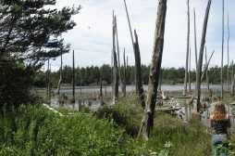
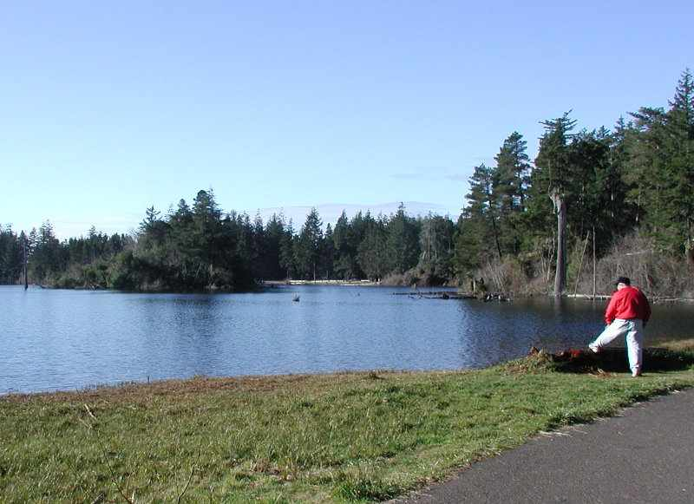
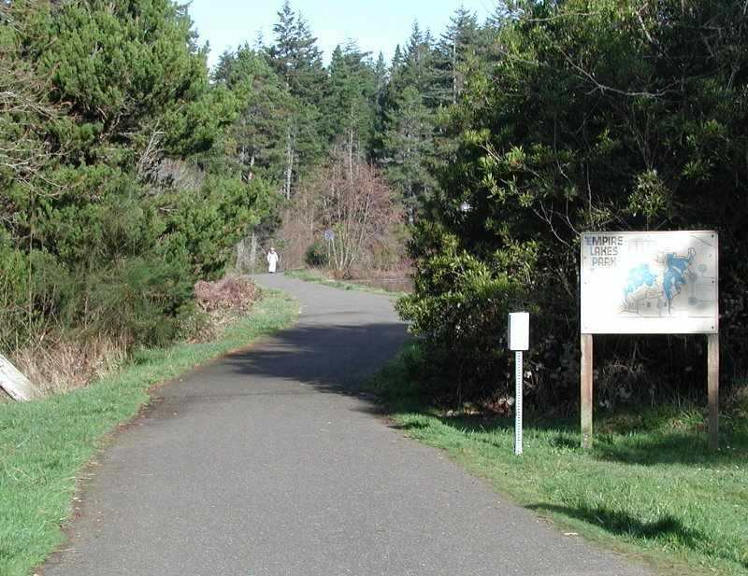
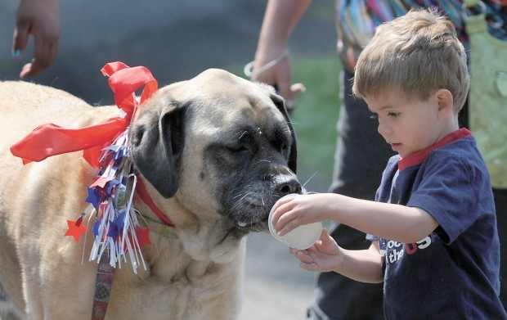
Question 6: What is the primary reason that you use parks in Coos Bay?
Notes:
Top three primary reasons:
Walk or bike for exercise.
Enjoy the outdoors / nature.
Participate in family activities.

Slide 8
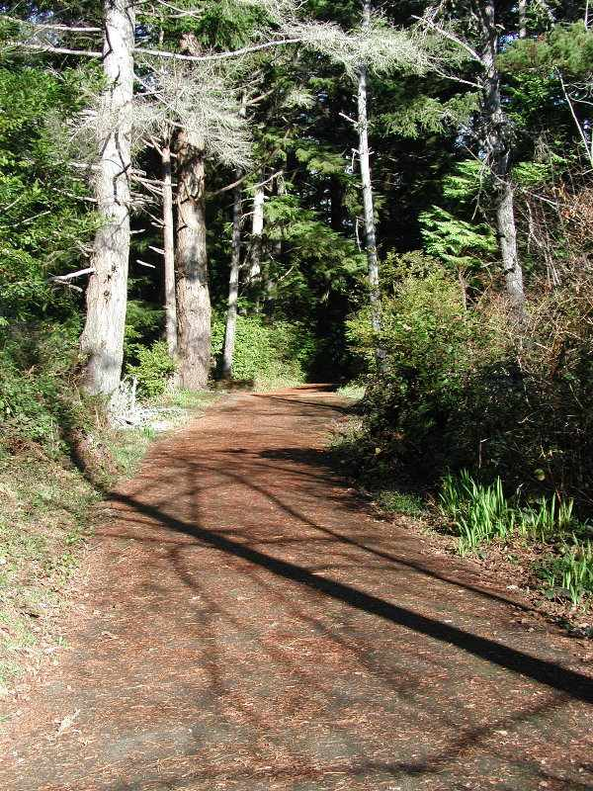
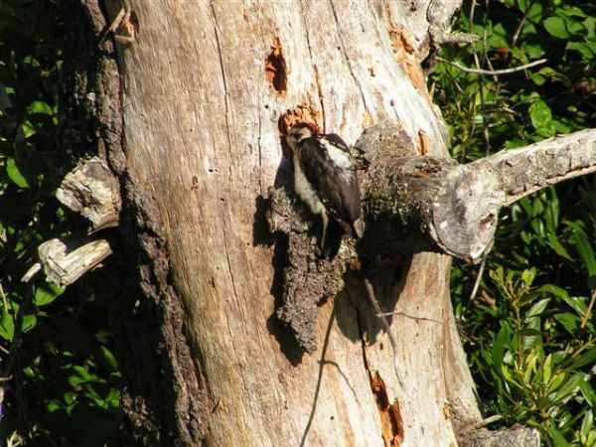
Question 7: How should natural areas be used?
Notes:
Top two choices:
Combination or mixed use; wildlife viewing, trails, view points, picnicking, playgrounds.
Depends on site specific.

Slide 9
Question 8: If you seldom use or do not use the parks or trails in Coos Bay, what are your reasons?
Notes:
Top three reasons:
Feel Unsafe
Poorly Maintained
Lack of Facilities

Slide 10
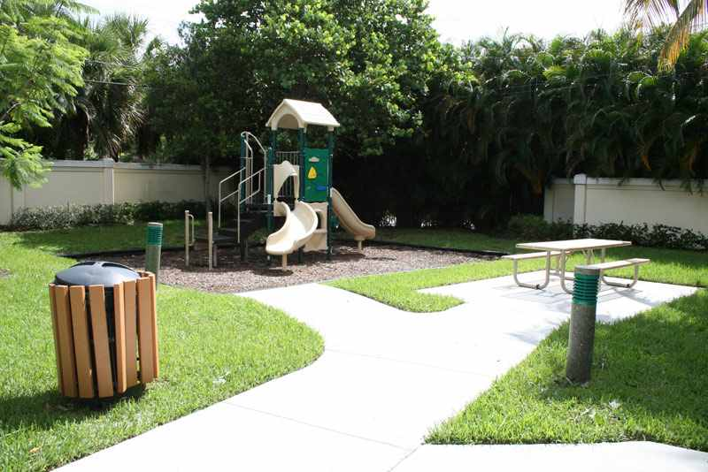

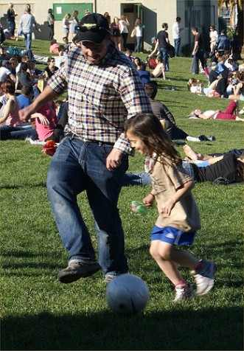
Question 9: What types of parks are most needed in Coos Bay?
Notes:
Top three most needed:
Dog Park.
Large Multi-use parks.
Neighborhood pocket parks / Natural Areas

Slide 11
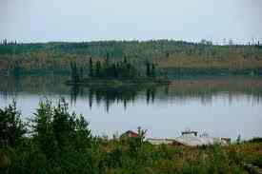
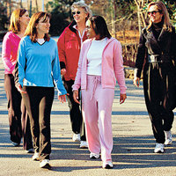
Question 10: What is the primary reason to develop more trails in Coos Bay?
Notes:
Top three reason to develop more trails:
Exercise
Experience Nature
Recreation opportunity

Slide 12
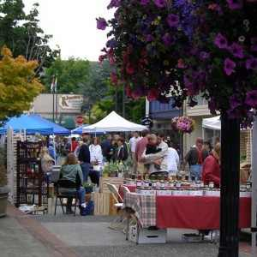
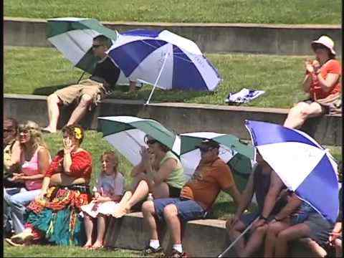
Question 11: Which age group is most underserved by current recreation services
Notes:
Top three underserved:
Seniors
All groups are adequately served
Adults

Slide 13
Question 12: What type of recreation facilities are currently most needed in Coos Bay?
Notes:
Top three recreational facilities needed:
Expand Boardwalk to include additional docks and restrooms.
Multimodal connectivity linking facilities together by way of bicycle and pedestrian access.
Community Center.

Slide 14
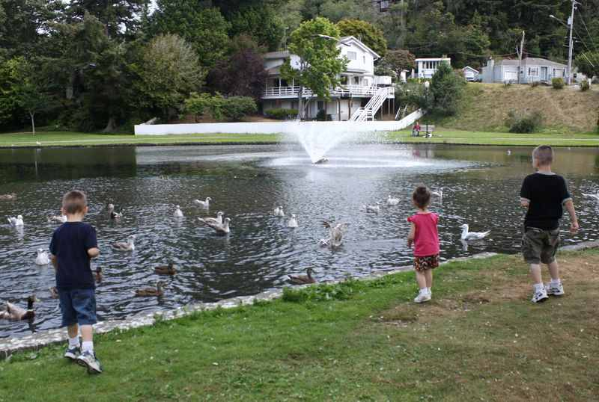
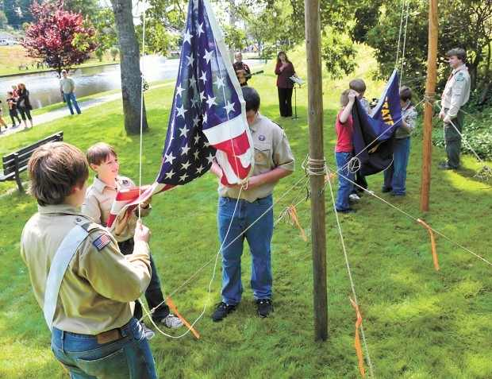
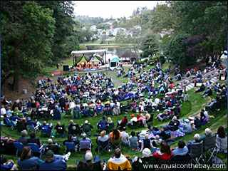
Question 13: What types of programs are most needed in Coos Bay?
Notes:
Top three programs needed:
Special events; concerts in the park, festivals, etc.
Outdoor environmental programs.
Before and after school programs.

Slide 15
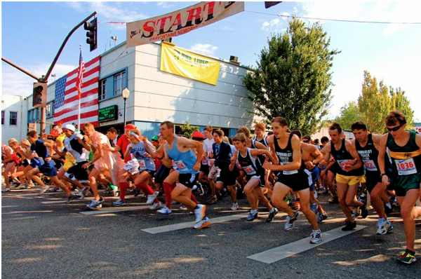
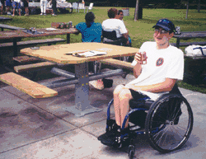
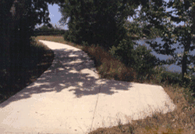
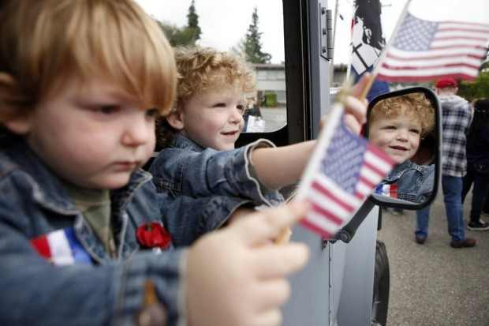
Question 14: Which other groups are underserved by current recreation services?
Notes:
Top three other groups underserved:
People with disabilities
All groups are adequately served
Families

Slide 16
NEXT STEP!
Parks Master Plan Analysis (January, 2013)
Community Intercept meetings (Feb-March 2013
Parks Master Plan Policy Direction (January, 2013)
Parks Master Plan Capital Improvements (CIP) (March, 2013)
Parks Master Plan Funding Strategies (April, 2013)
Draft Parks Master Plan (April, 2013)
Council Adopt Parks Master Plan (May-June, 2013)

Slide 17
Questions?
Thank You!
Notes:
Top three other groups underserved:
People with disabilities
All groups are adequately served
Families

